Slide 1


Matrix Chain Multiplication
Prepared by,
Solanki Kuldeepsinh Jitendrasinh
Roll No. : 53
Batch : S2
Branch : CSE
Matrix Chain Multiplication method is used to find the most efficient way to multiply matrices together

Slide 2
A
B
C
5 X 4
4 X 6
6 X 2
(AB)C= (5 * 4 * 6)+(5 * 6 * 2)
= 120 + 60
= 180
A(BC)= (5 * 4 * 2)+(4 * 6 * 2)
= 48 + 40
= 88

Slide 3
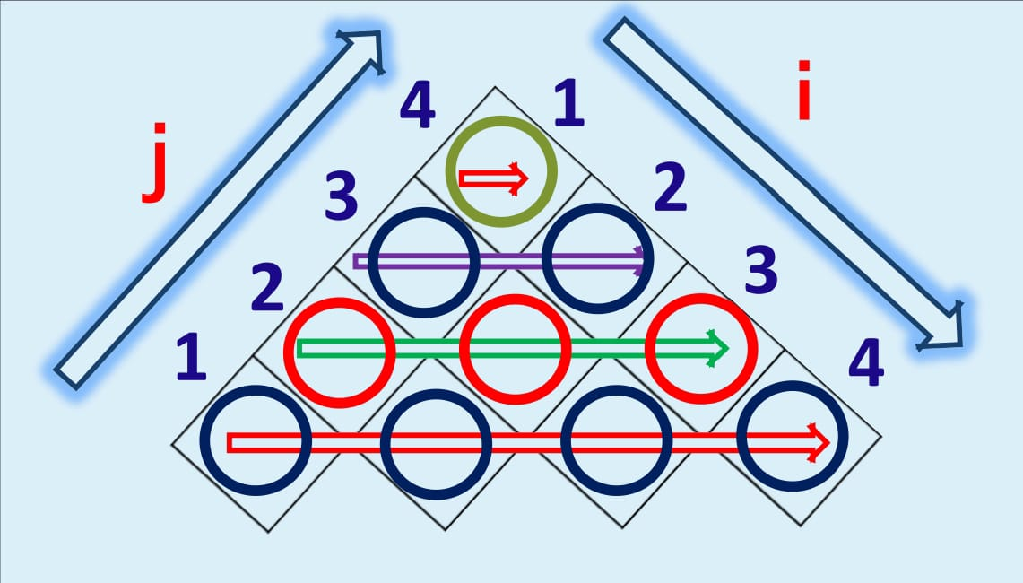
Formulas
m[i,j]=0 if i = j
m[i,j]=min(m[i,k]+m[k+1,j]+Pi-1PkPj)
if i < j where i <= k <= j-1

Slide 4
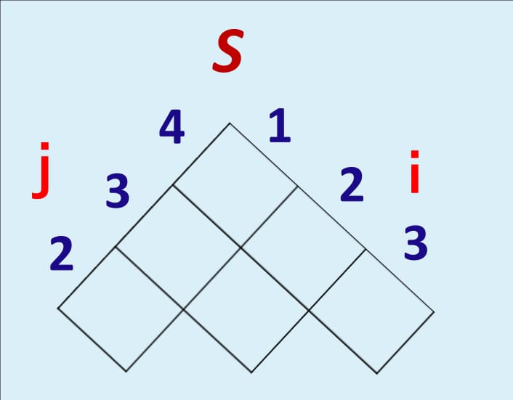
Formulas
Value of K is Put in this Array if the minimum value of the formula is found
According to Value in S Chain of Matrices was made

Slide 5
Thank You …!

